Slide 1
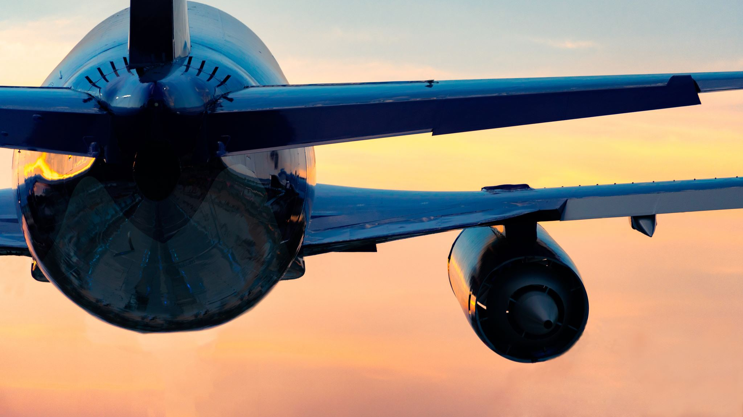
Boeing 737 MAX: Ignorance and Negligence
Lucca Anthony Marcondes Browning
Computer Science BSc
H00369673
Edinburgh

Slide 2
Introduction

Slide 3
Background Information
In 1997, Boeing merged with McDonnell Douglas.
Known in aviation for cost-cutting to keep profit margins high.
Air travel was becoming increasingly competitive in terms of travel speeds and fuel efficiency.
Airbus released the A320neo, which is 15% more fuel efficient than other aircraft models.
Boeing needed to release an aircraft that could compete against the A320neo to keep profits stable.
Hence, the Boeing 737 MAX was created.
Notes:
Sources:
Buenaluz (2022)
Calder (2021)
Defensebridge (2023)

Slide 4
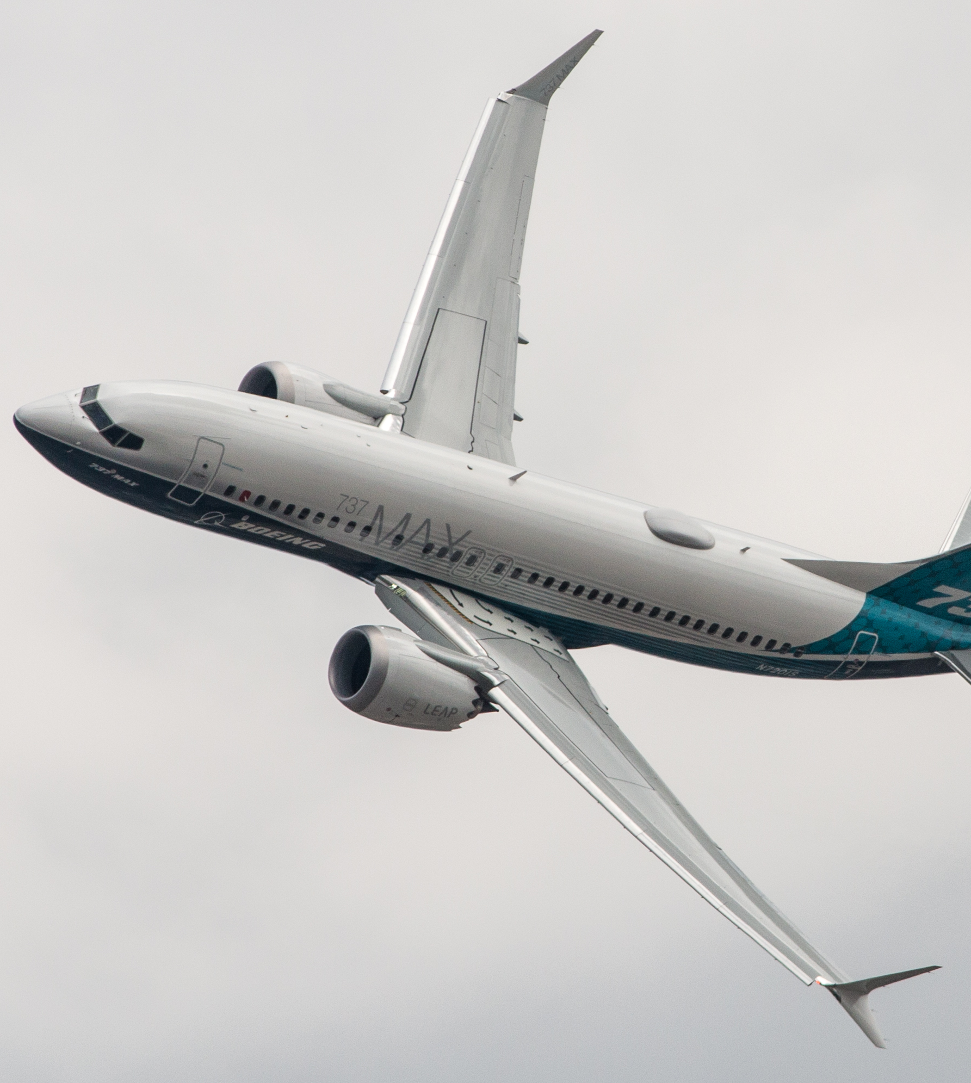
The 737 MAX
Fuel-efficient LEAP-1B engines:
Produced by CFM International.
Provide greater fuel economy and range compared to previous models.
Advanced aerodynamics to improve fuel efficiency and reduce noise.
New split-tip winglets.
Redesigned tail cone.
Re-designed flight deck displays that provide pilots with more information.
Maneuvering Characteristics Augmentation System (MCAS)
Figure 1: A photograph of the 737 Max
Notes:
Sources:
Boeing (2021)
Figure 1: Lynes (2018)

Slide 5
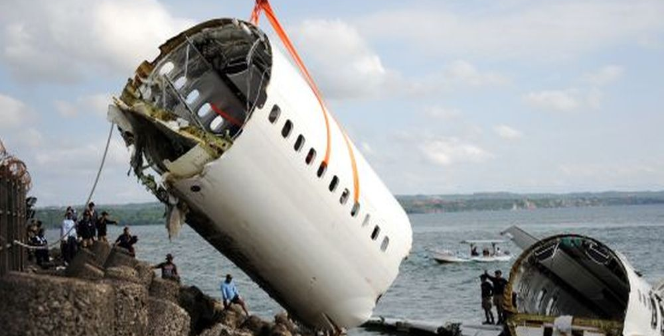
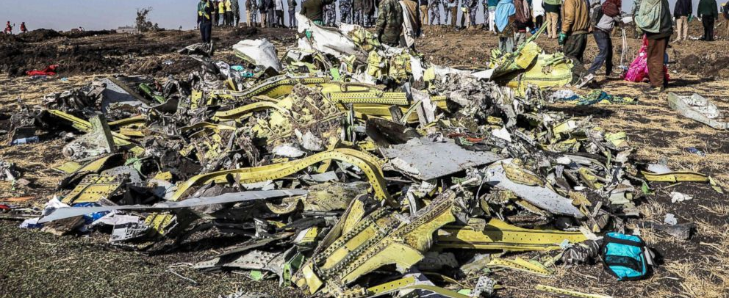
Flights JT610 and ET302
Lion Air Flight 610 crashed on October 29, 2018.
Ethiopian Airlines Flight 302 crashed on March 10, 2019.
Everyone on board both flights died.
Both crashes happened shortly after takeoff.
Both crashes involved the Boeing 737 MAX.
Issues with the plane's Maneuvering Characteristics Augmentation System (MCAS) played a significant role in both incidents.
The MCAS system malfunctioned and caused the plane to enter a dive, which the pilots were unable to recover from.
Figure 2: A photograph of the Lion Air Flight 610 Crash
Figure 3: A photograph of the Ethiopian Airlines Flight 302 Crash
Notes:
Sources:
Hopper (2019)
Figure 2: Outlook Editors (2018)
Figure 3: Miriri (2022)

Slide 6
Factors Contributing to the Crashes

Slide 7
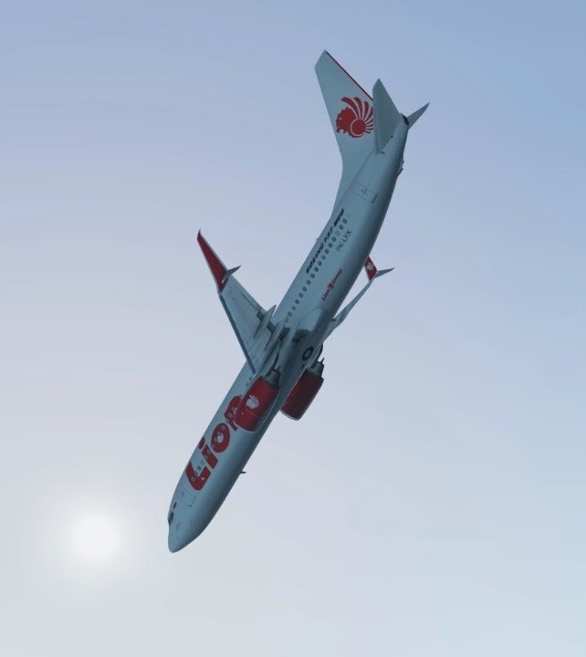
Maneuvering Characteristics Augmentation System (MCAS)
It was designed to automatically adjust the angle of the plane's horizontal stabilizers to prevent the plane from stalling.
It relied on data from only one angle of attack (AOA) sensor.
It was not thoroughly tested or adequately documented.
Some pilots were not made aware of its existence.
If the sensor failed, it would register as the plane stalling, and would start nosediving.
Figure 4: A recreation of the nosedive that led to the Lion Air Flight 610 Crash
Notes:
Sources:
Hopper (2019)
Figure 4: Avinations (2018)

Slide 8
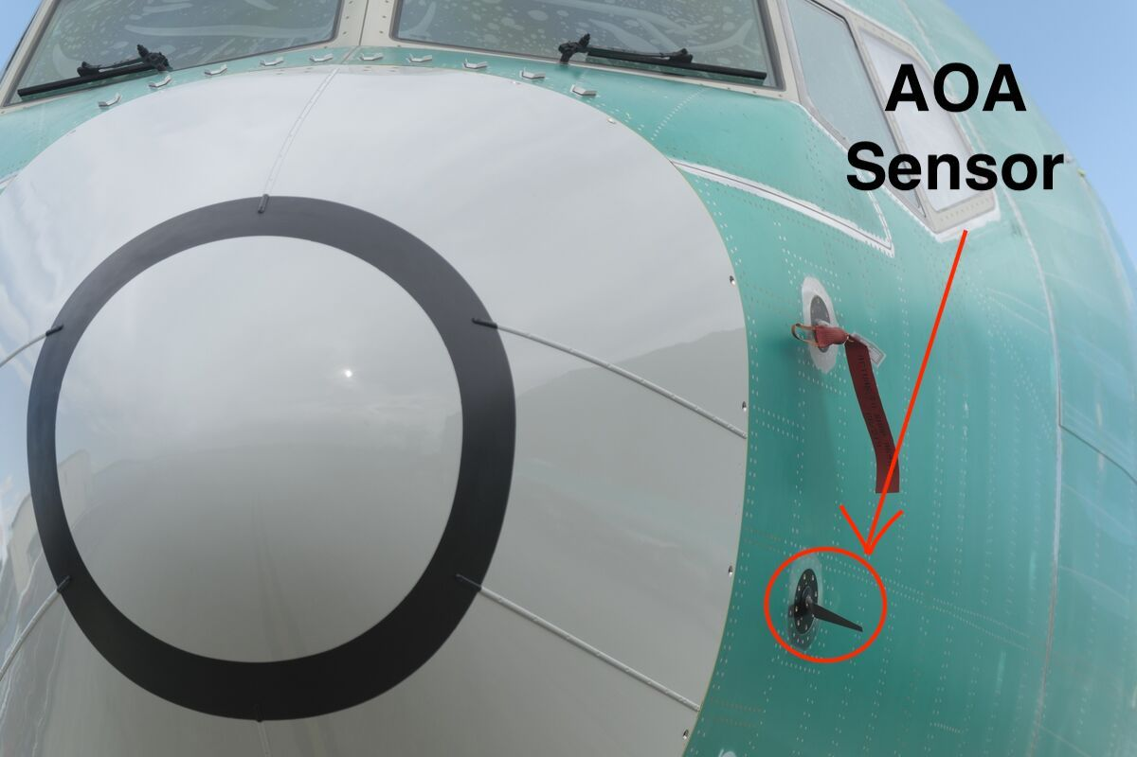
Placement of the AOA sensor
Figure 5: A Diagram representing placement of the AOA sensor.
Notes:
Sources:
Figure 5: Gates, Baker (2019), Marcondes Browning (2023)

Slide 9
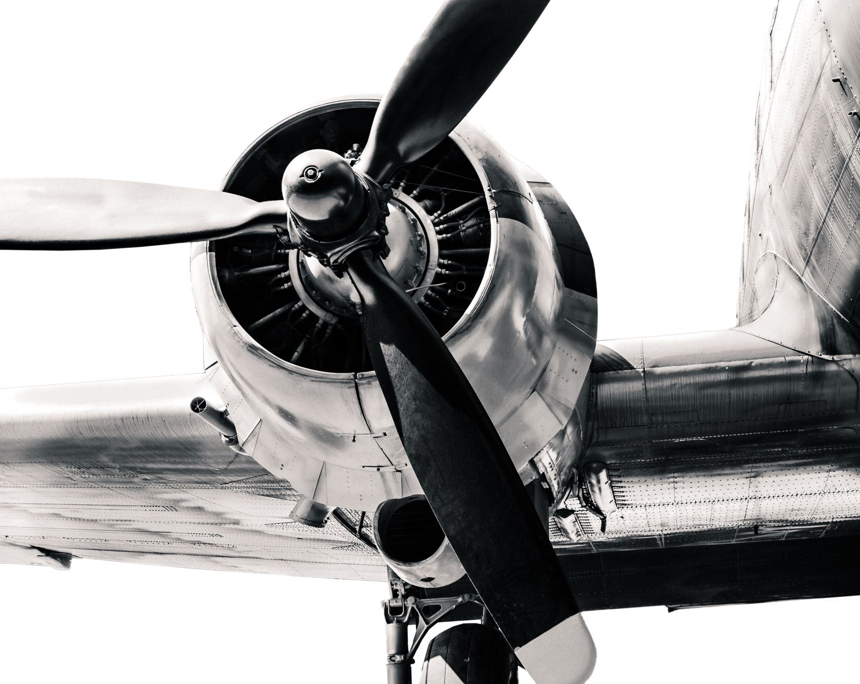
The Aerodynamics of the 737 MAX
The 737 MAX's new engines' aerodynamics without any mitigation would cause the plane to tilt upwards, leading to the potential of the plane stalling.
Instead of brainstorming ideas to change the body or engine of the plane, they put a band-aid over the problem, and created the problematic MCAS.
The MCAS was a cheaper solution. However, given the fact it had only one AOA sensor to give it angle of attack data, it had potential safety risks.
This lack of change was caused by the design philosophy adopted from keeping McDonnell Douglas' cost-cutting management structure.
Figure 6: A photograph of a plane engine.
Notes:
Sources:
Figure 6: PowerPoint Designer Library

Slide 10
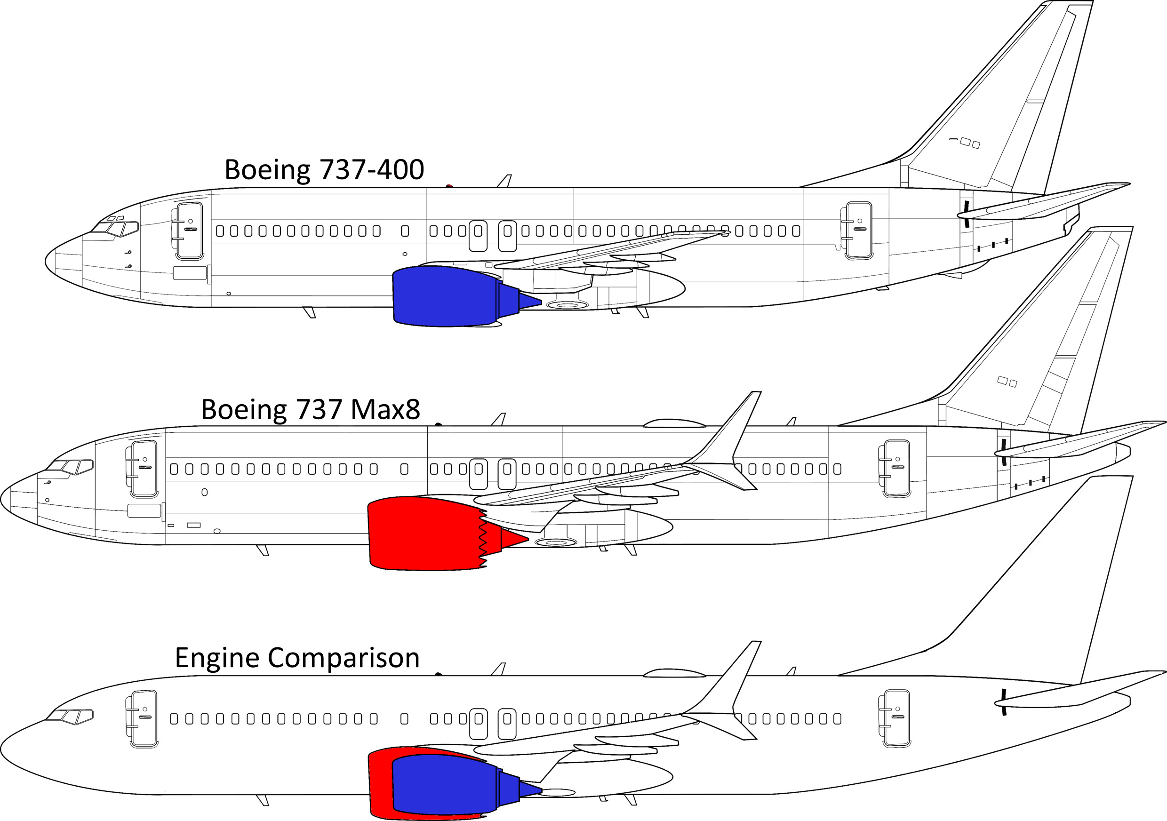
737 vs 737 MAX
Figure 7: Engine Comparison of the 737 vs the 737 MAX
Notes:
Sources:
Figure 7: Roser (2022)

Slide 11
The Secrecy Behind the MCAS
Before any disasters, Boeing knew the MCAS was problematic because...
The public, regulators, investors, and even many pilots weren't told about its existence.
They knew how much money they could lose if the wrong people found out the issues with the aircrafts.
When some pilots were faced with the 737 MAX nosediving, they had no idea what was happening.
They were not told about the MCAS
They may have been overwhelmed by the number of warning signals, alarms, and checklists they were presented with in the 737 MAX, leading to a breakdown in situational awareness and decision making.
Notes:
Sources:
Kerley (2019)

Slide 12
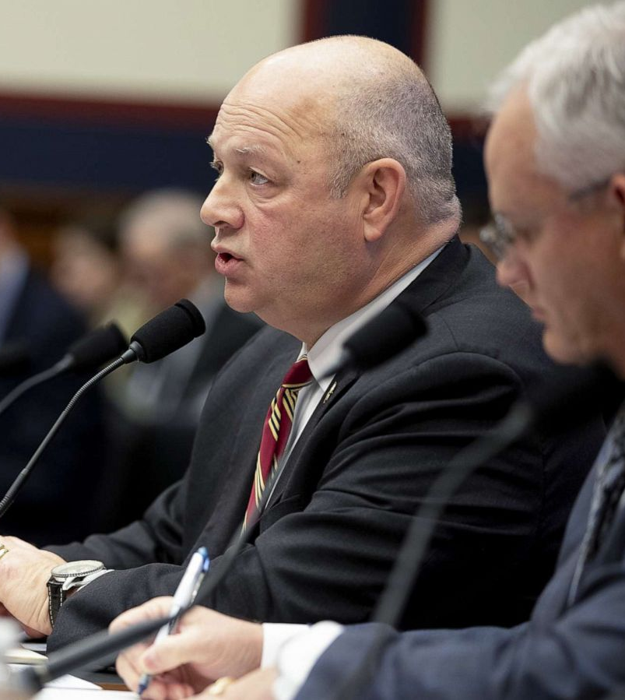
Boeing's Further Corruption
Boeing delegated significant responsibility for the design and certification of the 737 MAX to the Federal Aviation Administration (FAA), raising concerns about...
Potential conflicts of interest.
Lack of independent oversight.
These organizations weren't working in tandem or in a time efficient way.
One hand not knowing what the other is doing has historically led to disaster.
Figure 8: Federal Aviation Administrator Stephen M. Dickson speaks at a Oversight Hearing
Notes:
Sources:
Kerley (2019)
Figure 8: Kerley (2019)

Slide 13
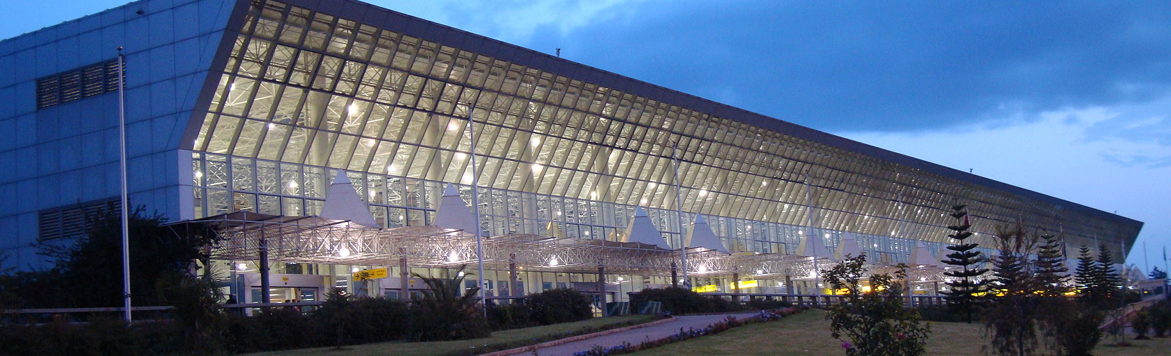
Negligence of Ground Staff
Figure 9: A photograph of the Addis Ababa Bole Airport
Ground staff may have missed/overlooked critical maintenance tasks.
Resulting in malfunctioning sensors, systems or components.
Could be caused by poor training and lack of expertise.
Notes:
Sources:
Beech (2019)
Broderick (2023)
Figure 8: Wikipedia Editors (2023)

Slide 14
Changes made to the 737 MAX

Slide 15
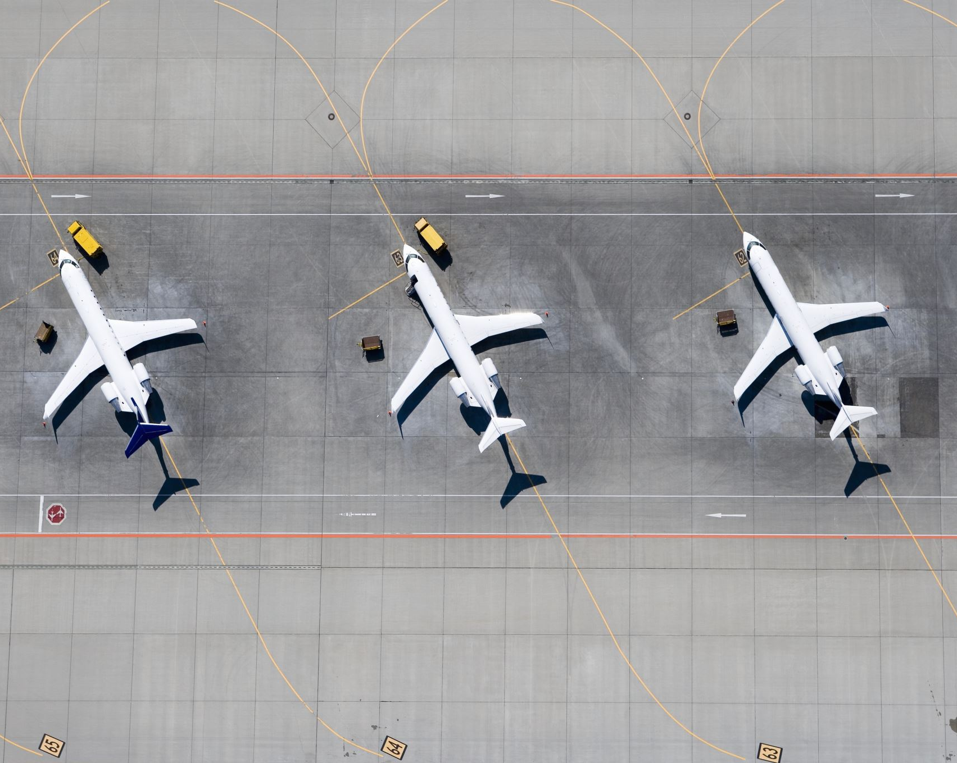
Changes made to the 737 MAX
Modifications to the MCAS system
The addition of a second AOA sensor.
They did this for the sake of redundancy (in case the first one fails).
Changes to the software's behavior improved...
Aircraft handling characteristics
Decrease pitch-up tendency at elevated angles of attack.
This makes it less likely for both the AOA sensors failing to cause the plane to nosedive.
Figure 10: A photograph of several planes.
Notes:
Sources:
Figure 10: PowerPoint Designer Library

Slide 16
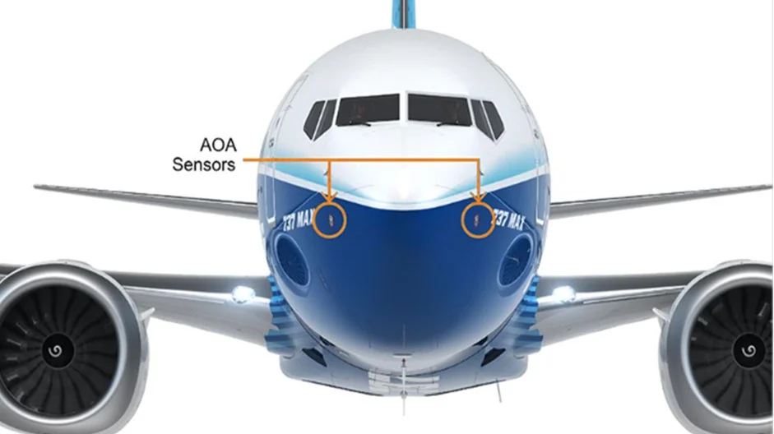
737 MAX after a second AOA sensor was added.
Figure 11: New 737 MAX after the extra AOA sensor was added.
Notes:
Sources:
Figure 11: Hamblen (2020)

Slide 17
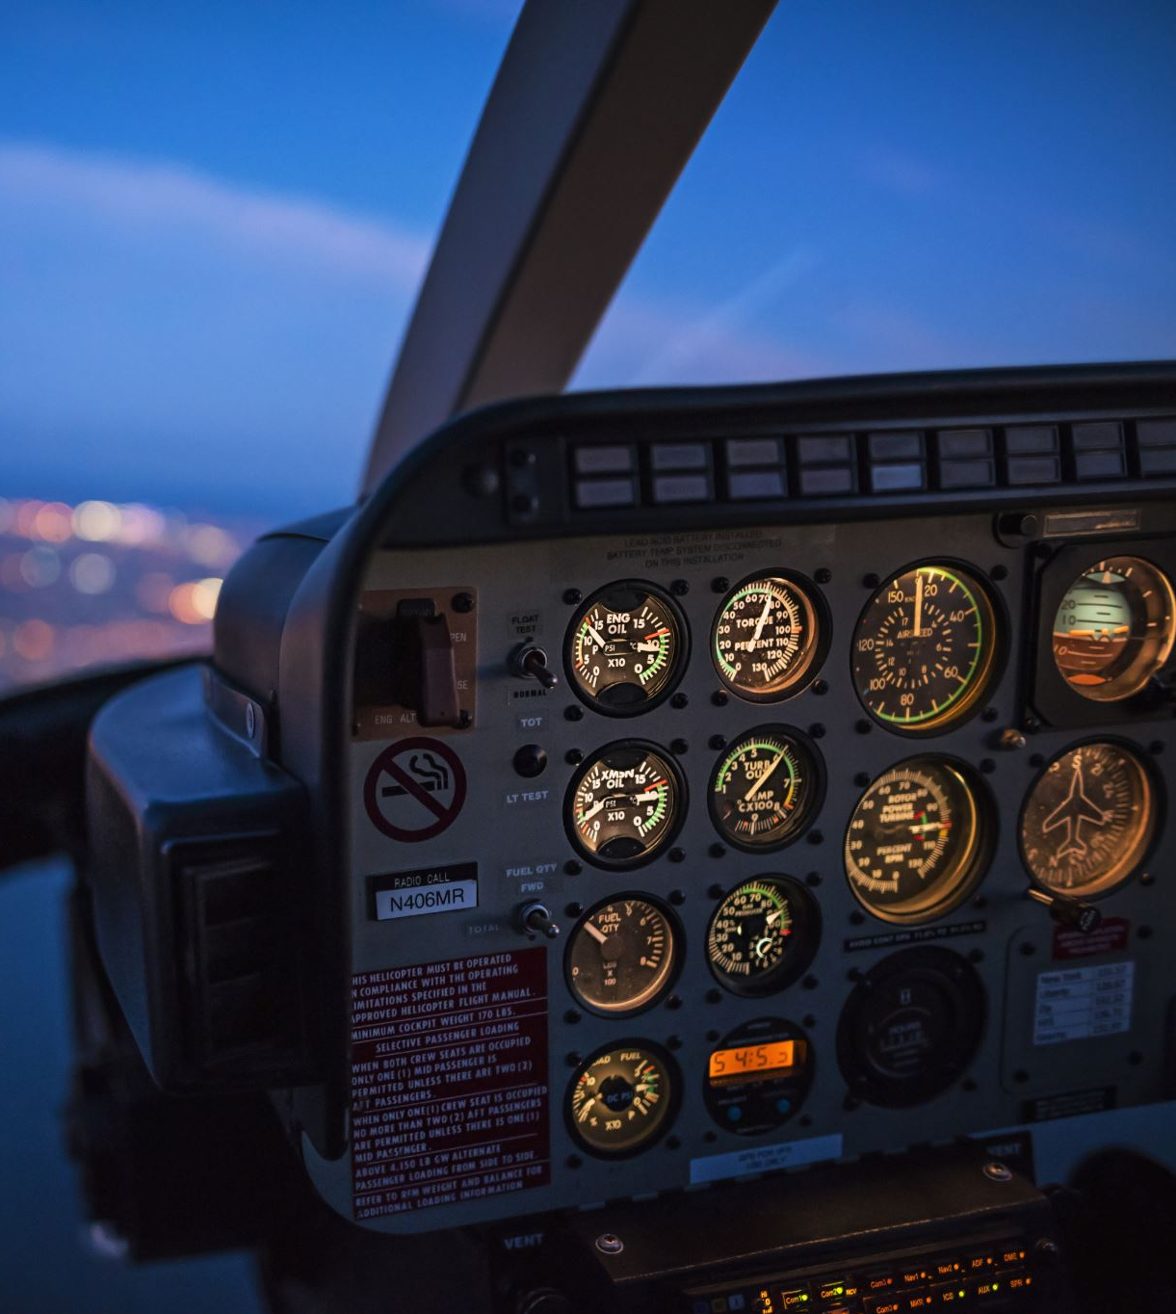
Changes made to Quality and Safety
Updates to pilot training and manuals to include the MCAS system.
Pilots know how to react if the plane starts nosediving.
Pilots understand what the new flight deck displays include.
More thorough reviews of automated systems (like MCAS) by the FAA
Any potential bugs have a higher chance to be found.
New quality control to ensure all parts and systems are properly tested and certified by Boeing
Any potential deformities that would cause troubles have a higher chance to be found.
Figure 12: A photograph of the inside of a plane cockpit

Slide 18
Changes to Avoid Corruption
Improved communication with customers.
This reduced the number of hidden money-saving 'mechanisms' that could potentially be harmful because customers would not want to work with Boeing if their lives/money would be in danger.
This is now done in a timely manner to further improve the aforementioned effect.
Improved communication with regulatory authorities.
This reduced any potential problems with aircrafts not passing current regulatory standards.
This is also now done in a timely manner.
The FAA ordered a completely independent review of the 737 MAX.
This was done to avoid creating/fostering a conflict of interests.

Slide 19
Conclusion
Issues with the 737 MAX's Maneuvering Characteristics Augmentation System (MCAS) contributed to..
Lion Air Flight 610 crash on October 29, 2018.
Ethiopian Airlines Flight 302 crash on March 10, 2019.
The issues with MCAS were caused by:
Insufficient testing and regulation.
Poor aerodynamics on the aircraft, leading to the creation of the MCAS.
Afterwards, these problems were solved by:
Increased redundancy with the addition of another AOA sensor.
Far more testing and regulation.

Slide 20
Sources Page 1:
Beech, H. and Suhartono, M. (2019) With Boeing in cross hairs, Lion Air gets a pass on poor safety record, The New York Times. The New York Times. Available at: https://www.nytimes.com/2019/11/24/world/asia/lion-air-boeing-indonesia.html (Accessed: April 9, 2023).
Boeing, B. (2021) 737 MAX, Boeing. Available at: https://www.boeing.com/commercial/737max/ (Accessed: April 9, 2023).
Broderick, S. (2023) Ethiopian-led 737 MAX probe ignores human factors issues, Aviation Week Network. Available at: https://aviationweek.com/air-transport/safety-ops-regulation/ethiopian-led-737-max-probe-ignores-human-factors-issues (Accessed: April 9, 2023).

Slide 21
Sources Page 2:
Buenaluz, D. (2022) McDonnell Douglas: Commercial success at the cost of Greed, The Arcadia Quill. The Arcadia Quill. Available at: https://arcadiaquill.com/17626/opinion/mcdonnell-douglas-commercial-success-at-the-cost-of-greed/ (Accessed: April 9, 2023).
Calder, S. (2021) Boeing 737: History and safety record of the Aeroplane, The Independent. Independent Digital News and Media. Available at: https://www.independent.co.uk/travel/news-and-advice/boeing-737-crash-indonesia-flight-safety-airplane-b1784904.html (Accessed: April 9, 2023).
Defensebridge. (2023) The Airbus A320, Defensebridge. Defensebridge. Available at: https://defensebridge.com/article/the-airbus-a320neo-family-cutting-edge-efficiency-and-reliability.html#:~:text=The%20Airbus%20A320neo%20is%20up,levels%20as%20well%20as%20emissions. (Accessed: April 9, 2023).

Slide 22
Sources Page 3:
Hopper, T. (2019) Not everyone who encountered the max 8's fatal flaw was killed by it, National Post. Available at: https://nationalpost.com/news/not-everyone-who-encountered-the-max-8s-fatal-flaw-was-killed-by-it (Accessed: April 9, 2023).
Herkert, J., Borenstein, J. and Miller, K. (2020) The Boeing 737 MAX: Lessons for Engineering Ethics. Science and Engineering Ethics.
Johnston, P. and Harris, R. (2019) The Boeing 737 MAX Saga: Lessons for Software Organizations. No.3: Software Quality Professional.
Kerley, D., Kaji, M. and Vann, M. (2019) FAA chief tells lawmakers aircraft certification system 'is not broken,' despite Boeing 737 Max crashes, ABC News. ABC News Network. Available at: https://abcnews.go.com/Politics/faa-chief-tells-lawmakers-aircraft-certification-system-broken/story?id=67653188 (Accessed: April 9, 2023).

Slide 23
Figure Sources Page 1:
Figure 1:
Lynes, S. (2018) EGLF - Boeing 737 MAX - N120IS, Flickr. Yahoo! Available at: https://www.flickr.com/photos/lynothehammer/43406207022/ (Accessed: April 9, 2023).
Figure 2:
Outlook Editors. (2018) Indonesia calls off search for Lion Air Crash Victims, https://www.outlookindia.com/. Available at: https://www.outlookindia.com/website/story/indonesian-calls-off-search-for-lion-air-crash-victims/319901 (Accessed: April 9, 2023).

Slide 24
Figure Sources Page 2:
Figure 3:
Miriri, D. (2022) U.S. safety experts dispute aspects of Ethiopia 737-Max Air Crash Findings, Reuters. Thomson Reuters. Available at: https://www.reuters.com/world/us-safety-experts-dispute-aspects-ethiopia-737-max-air-crash-findings-2022-12-28/ (Accessed: April 9, 2023).
Figure 4:
Avinations. (2018) Lion Air Flight JT610 - Crash Animation [X-plane 11], YouTube. YouTube. Available at: https://www.youtube.com/watch?v=4h8GTXK3e2g (Accessed: April 9, 2023).

Slide 25
Figure Sources Page 3:
Figure 5 Photograph:
Levin, A. and Beene, R. (2019) Boeing 737 MAX crashes: Sensors vulnerable to failure, Bloomberg.com. Bloomberg. Available at: https://www.bloomberg.com/news/articles/2019-04-11/sensors-linked-to-737-crashes-vulnerable-to-failure-data-show (Accessed: April 10, 2023).
Figure 5 Annotations: Lucca A. M. Browning
Figure 6:
PowerPoint Designer Library. (Accessed: April 9, 2023)

Slide 26
Figure Sources Page 4:
Figure 7:
Roser, C. et al. (2022) How managers drove Boeing into the ground..., AllAboutLean.com. All About Lean. Available at: https://www.allaboutlean.com/boeing-management/ (Accessed: April 9, 2023).
Figure 8:
Kerley, D., Kaji, M. and Vann, M. (2019) FAA chief tells lawmakers aircraft certification system 'is not broken,' despite Boeing 737 Max crashes, ABC News. ABC News Network. Available at: https://abcnews.go.com/Politics/faa-chief-tells-lawmakers-aircraft-certification-system-broken/story?id=67653188 (Accessed: April 9, 2023).

Slide 27
Figure Sources Page 5:
Figure 9:
Wikipedia Editors. (2023) Addis Ababa Bole International Airport, Wikipedia. Wikimedia Foundation. Available at: https://en.wikipedia.org/wiki/Addis_Ababa_Bole_International_Airport#/media/File:Bole_international_airport.jpg (Accessed: April 9, 2023).
Figure 10:
PowerPoint Designer Library. (Accessed: April 9, 2023)

Slide 28
Figure Sources Page 6:
Figure 11:
Hamblen, M. (2020) Killer software: 4 lessons from the deadly 737 max crashes, Fierce Electronics. Available at: https://www.fierceelectronics.com/electronics/killer-software-4-lessons-from-deadly-737-max-crashes (Accessed: April 10, 2023).
Figure 12:
PowerPoint Designer Library. (Accessed: April 10, 2023)

Slide 29
Further Notes
The pages of the slideshow that have specific sources used for those pages alone (other than the two papers specified by the coursework) are sourced in the notes section.

